Slide 1

SHOES STORE WEBSITE
By
Swapan Kumar Shee
(B.Tech 2nd Year, Enrollment No.:12021002001009 )
Arka Chatterjee
(B.Tech 2nd Year, Enrollment No.:12021002001013 )
Shivam Kumar Mishra
(B.Tech 2nd Year, Enrollment No.:12021002001042 )
Under the Supervision of
Prof. Jyoti Khandelwal
Dept. of Computer Science & Engineering
University of Engineering & Management, Jaipur

Slide 2
Outlines
Introduction
Literature Review
Objectives
Proposed Model
Experimental Setup
Result Analysis
Conclusion & Future Scope
Reference
Acknowledgement

Slide 3
Introduction
The "Online Shoes Store Website " has been developed to override the problems prevailing in the offline store. This website is supported to eliminate and, in some cases, reduce the hardships faced by this existing system. Moreover, this system is designed for the particular need of the company to carry out operations in a smooth and effective manner.
The website is understandable to anyone. No formal knowledge is needed for the user to use this system. Thus, by this all it proves it is user-friendly. Online Shoes store, as described above, can lead to error free, secure, reliable and fast management system. It can assist the user to concentrate on their other activities rather to concentrate on the record keeping. Thus, it will help organization in better utilization of resources.

Slide 4
Literature Review
According to the (IOSR Journal of Business and Management 9(4):53-61, January 2013 DOI:10.9790/487X-0945361), this study reveals and illustrates how online shoe store customer's perspective about e-Service Quality, e-Satisfaction and e-Loyalty, as expressed in online customer reviews. The discussion associated with the online shopping phenomenon for the search good and experience good category in apparel product lines - especially shoes. Using data from Zappos.com's customer reviews, interpretive analysis which focused on customer evaluations of the service quality, and how the customer connects it to satisfaction and loyalty.
According to the (https://www.researchgate.net/publication/289521455_SHOPIFY-An_Interactive_Online_Shoe_Shop_System), in order to let user experience trustful and efficient online shoe shopping, SHOPIFY, a system to measure users’ feet and suggest them shoes that definitely will fit, was designed. It includes a hardware which is a smart scale (weight scale), embedded with highly customized mobile or tablet application solution. The strategy behind this system is to let users select shoes among a list of shoes that will fit them. User interviews were conducted, in order to understand the users’ main issues while shoe online shopping, their lifestyle and their expectation toward the system. Based on interviews and analysis, a physical prototype along with a software prototype were tested, and evaluated as attractive.

Slide 5
Objectives
The main objective of the online shoe store is to manage the details of the shoes, customer, payment, and delivery.
To available all the new featured shoes in our website for the customers in time from offline market.
Customer can easily order their favorite shoes without wasting any time in offline stores.
To give the facility of home delivery to the customer in a less time through our fastest delivery system.
To reach maximum customers at right time to increase our profitability of the business

Slide 6
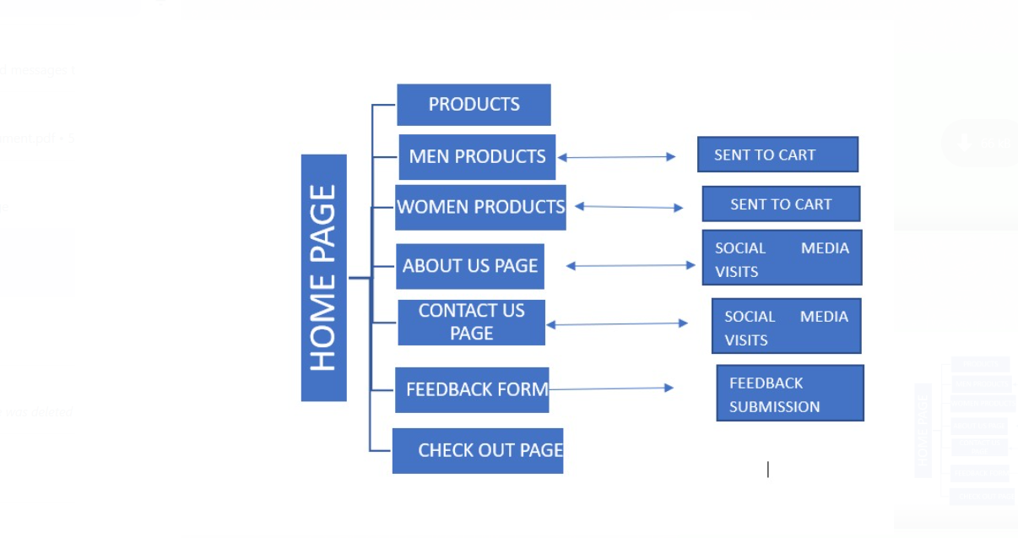
Proposed Model
Flow chart of the project

Slide 7
Experimental Set-up
Software used | Used Version
Visual Studio Code | October 2022 (version 1.73)
XAMPP Server | XAMPP Control Panel v3.3.0
Browser | Chrome-Version 107.0.5304.108 (Official Build) (64-bit)

Slide 8
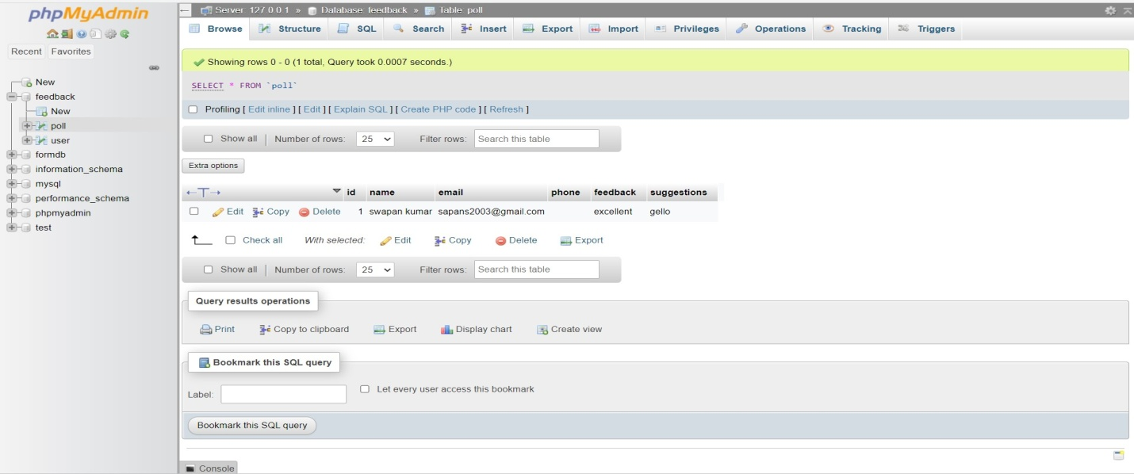
Result:
Fig.1. Data stored in xampp server

Slide 9
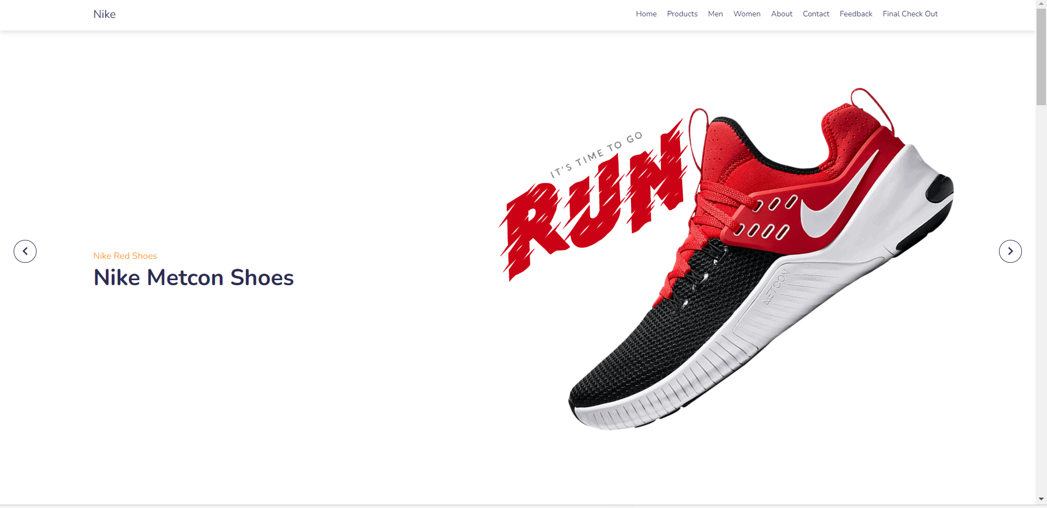
Result cont.…..
Fig .2(Home page)

Slide 10
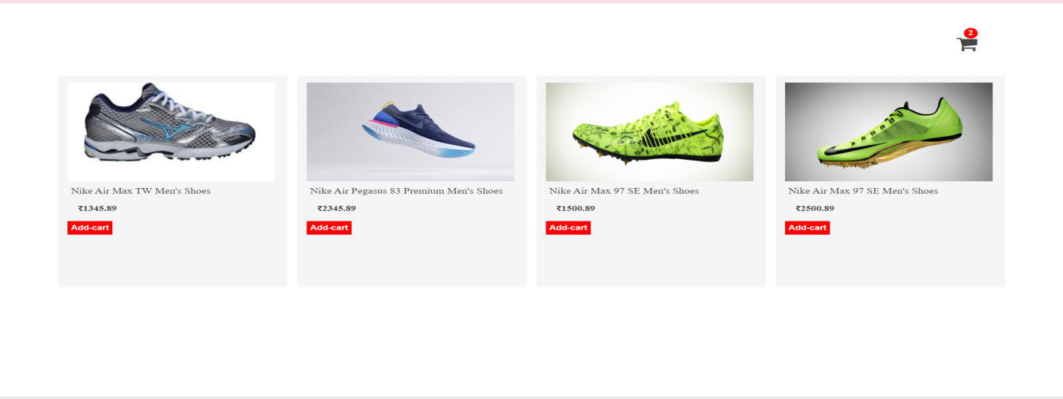
Result cont.….
Fig.3(Men products)

Slide 11
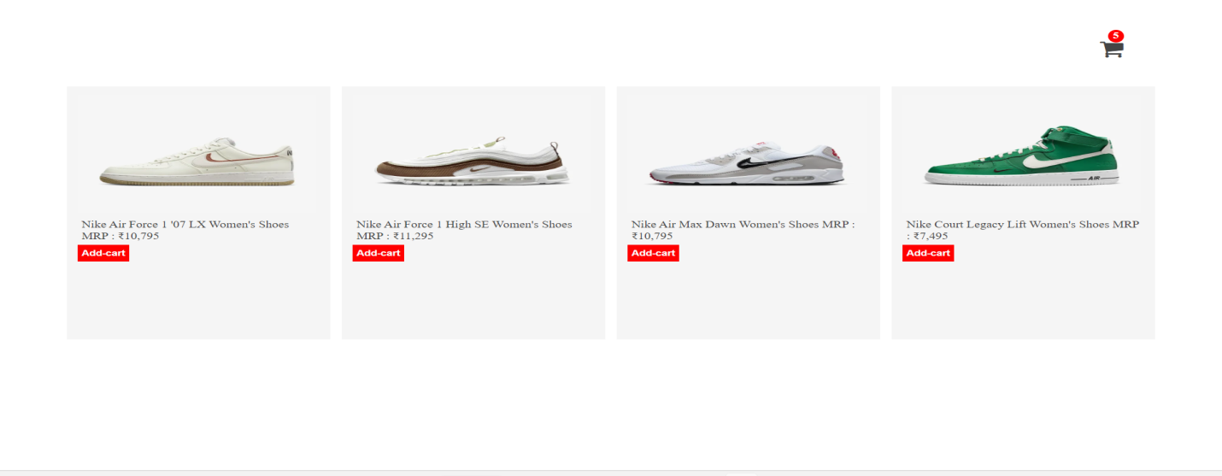
Result: cont.….
Fig.4(. Women products)

Slide 12
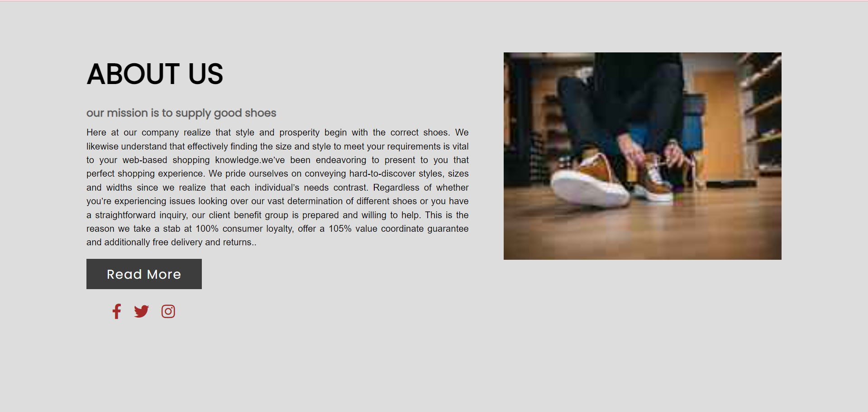
Result: cont.….
Fig .5( About us page)

Slide 13
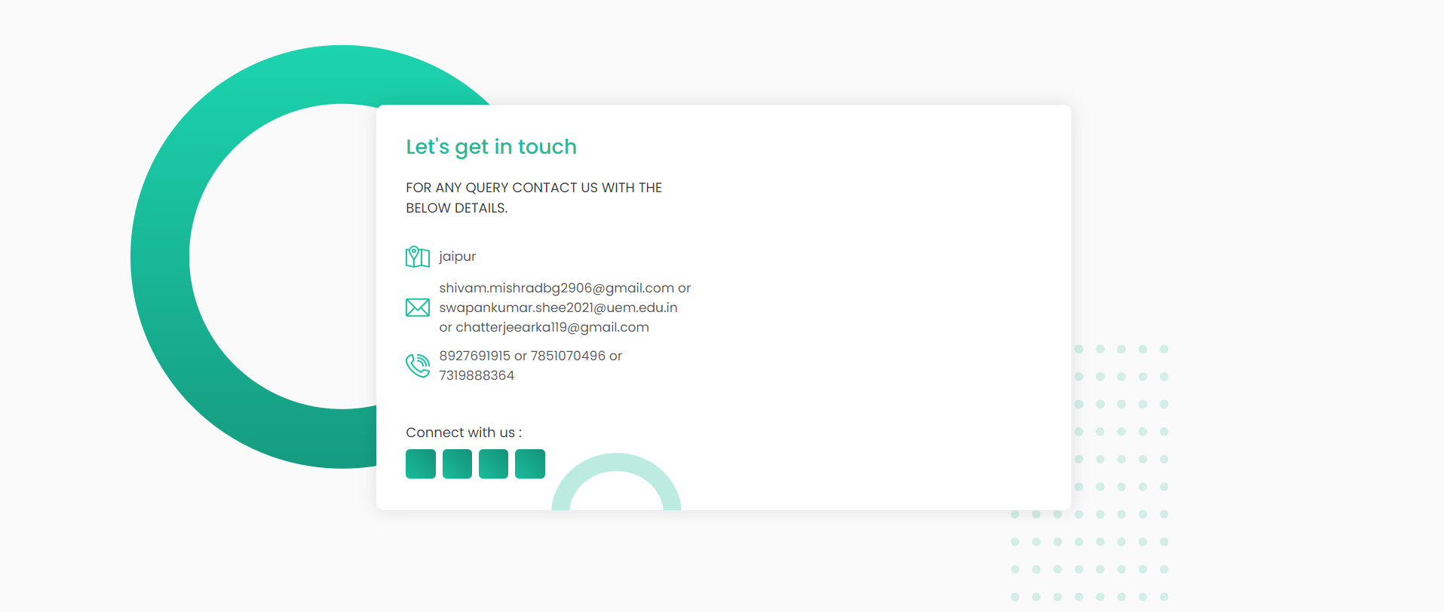
Result cont.….
Fig.6(Contact Us Page)

Slide 14
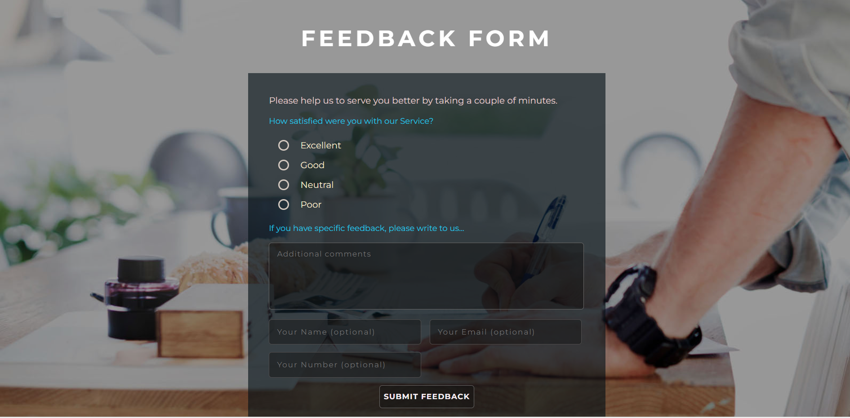
Result cont.….
Fig.7(Feedback Form)

Slide 15
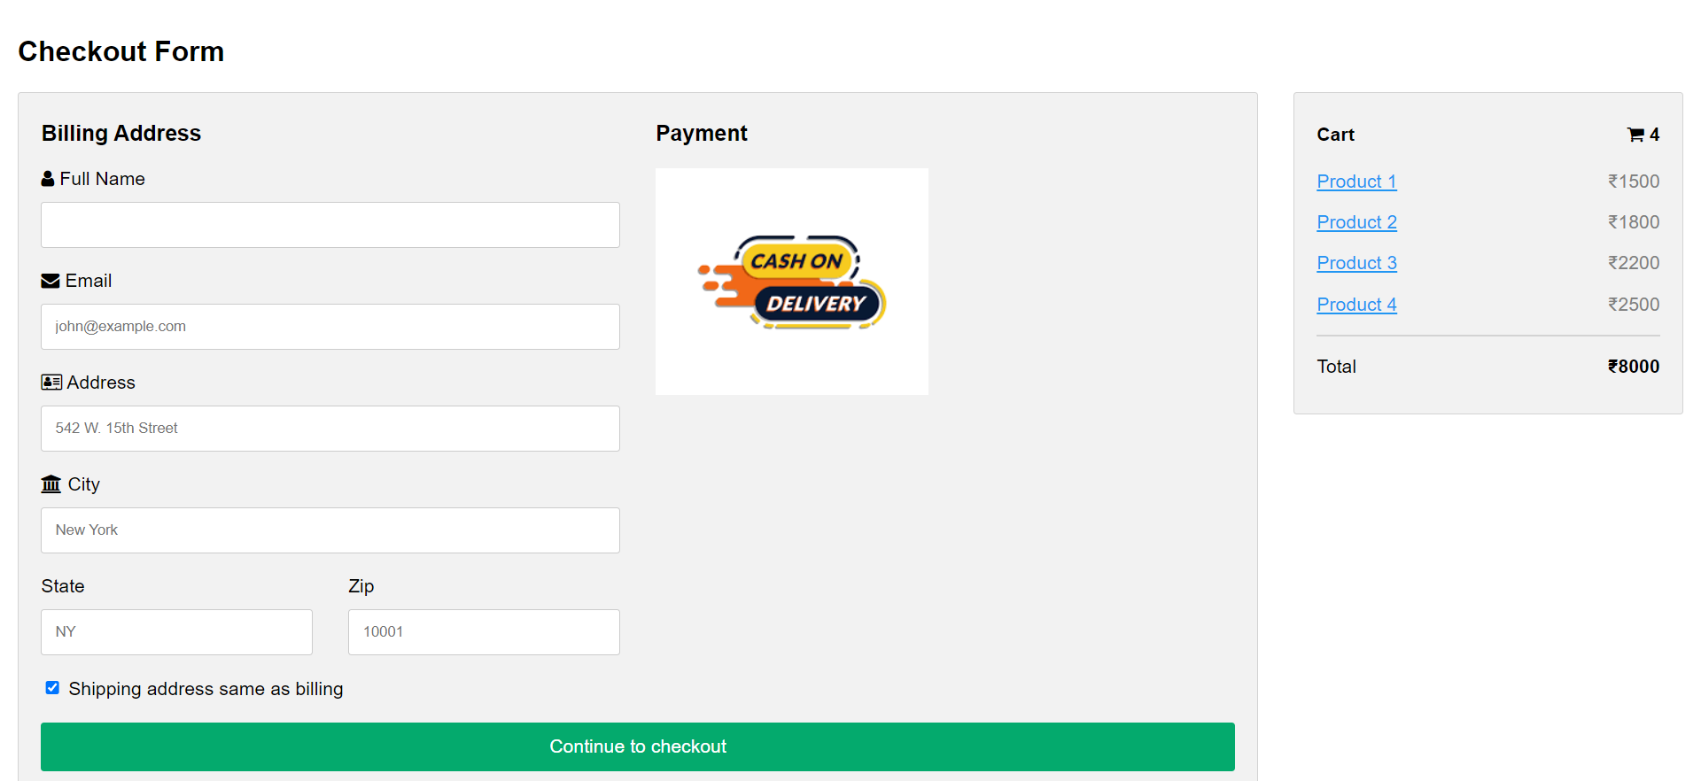
Result cont.….
Fig.8( checkout page)

Slide 16
Result Analysis
If any customer give their valuable feedback through the feedback form it can easily stored in our database so that we can checked it early.
We kept all the modules in the single home page like all the featured products ,prices, discounts, about sections, contact us sections.
Customer will get all the featured products in one single click.
Customer can easily contact with us as the mobile number is given as well as we have given email id,Address also.

Slide 17
Limitation
We have not used payment gateway properly as internet banking is very much essential in our day to day life. We have insert only the cash on delivery option.
If any customer give the feedback he/she will not get any notification through the email which is the limitation.
We have give limited number of products for choosing .There is not much product in any section.
If any new product will come in our store we are unable to send the notification to customer.

Slide 18
Conclusions & Future Scope
We define the problem on which we are working with the project. We describe the requirement specifications of the system and the actions that can be done on these things. We include features and operations in detail, including screen layouts. We designed user interface and finally the system is implemented and tested accordingly.
We can enable our internet banking gateway with our cash on delivery.
We can strong the backend of our website and also enable the notification system to customer.
We will host the platform on the online servers to make it accessible worldwide.
We can add another section of Kids products in our website.
We can give more advance software for online shoes store including more facilities.

Slide 19
References
[1]. January 2013 IOSR Journal of Business and Management 9(4):53-61.DOI:10.9790/487X-0945361.
[2]. E-Commerce Information System design in web-based UD Anggun Shoe Store. (n.d.). Retrieved December 2, 2022, from https://www.researchgate.net/publication/365118349_E-Commerce_Information_System_Design_in_Web-Based_UD_Anggun_Shoe_Store
[3].Herdianto, A. (1970, January 1). Futsal Shoe Store website with PHP, MySQL, Adobe Dreamweaver CS3: Semantic scholar. undefined. Retrieved December 2, 2022, from https://www.semanticscholar.org/paper/FUTSAL-SHOE-STORE-WEBSITE-WITH-PHP%2C-MYSQL%2C-ADOBE-Herdianto/c111982e495e693b892e188ae6f8072a687dc2c2
[4]. Impact of service quality on customer loyalty and customer satisfaction ... (n.d.). RetrievedDecember2,2022,fromhttps://journals.sagepub.com/doi/full/10.1177/2158244020919517 .
[5]. Shoes: Women's, Men's & Kids Shoes from top brands | DSW. (n.d.). Retrieved December 2, 2022, from https://www.dsw.com/
[6]. Dronca, R. (2020, June 29). How to create a shopping cart UI using CSS & JavaScript. Designmodo. Retrieved November 29, 2022, from https://designmodo.com/shopping-cart-ui/

Slide 20
Acknowledgement
The endless thanks goes to Lord Almighty for all the blessings he has showered onto me, which has enabled me to write this last note in my project work. During the period of my project, as in the rest of my life, I have been blessed by Almighty with some extraordinary people who have spun a web of support around me. Words can never be enough in expressing how grateful I am to those incredible people in my life who made this thesis possible. I would like an attempt to thank them for making my time during my project in the Institute a period I will treasure. I am deeply indebted to my research supervisor, Professor Jyoti Khandelwal me such an interesting thesis topic. Each meeting with him added in valuable aspects to the implementation and broadened my perspective. He has guided me with his invaluable suggestions, lightened up the way in my darkest times and encouraged me a lot in the academic life.

Slide 21

Dept. of CSE, University of Engineering & Management Jaipur

